Slide 1


MSc Computer Science · Team Project
Find your Dublin
Matching international students to the right Dublin area — by budget, commute and lifestyle.
Notes:
Welcome. We are The Crib Crew. Our project: an explainable, multi-criteria recommendation system that helps international students identify their Dublin residential area by financial, commuting and lifestyle preferences.

Slide 2




THE PROBLEM
“Given my budget, my campus and what I care about — which part of the city suits me?”
Today, the answer is scattered across:
Forums
Word of mouth
Property listings
The Crib Crew · Find your Dublin · 2
Notes:
When international students arrive in Dublin, they have limited reliable, personal information to decide where to live. Advice is shared on forums, by word of mouth and in property listings — but none of it answers the question that really matters: given my budget, my campus and the things I care about day to day, which part of the city will suit me?

Slide 3



How it works, in three steps
1
Tell us about you
2
Rate what matters
3
Get your shortlist
University, monthly budget, room type
Eight everyday priorities, weighted by you
Ranked areas, a match score and the reasons
The Crib Crew · Find your Dublin · 3
Notes:
A student first fills in their university, monthly spending and accommodation type. Then they rate how important accommodation, commute time, grocery access, international food, gyms, parks, public transport and healthcare are to them. These preferences are compared against a dataset collated for every Dublin district, and the student gets a shortlist of areas, each with a match score and a plain-language explanation.

Slide 4








Eight things students rate
Accommodation
Commute time
Groceries
International food
Gyms
Parks
Public transport
Healthcare
The Crib Crew · Find your Dublin · 4
Notes:
These are the eight criteria each student rates for importance. The weights they choose drive the match score for every district.

Slide 5






One student, one match
€900 / month
Own room — no sharing
Dublin 7
Loves South Asian food
Uses public transport
Wants parks nearby
The Crib Crew · Find your Dublin · 5
Notes:
An example from our plan: a student with a €900 monthly budget who does not want to share a house, wants to eat South Asian food, uses public transport and wants nearby parks could be matched to Dublin 7, because its characteristics fit her needs. The map is a stylised illustration, not real district boundaries.

Slide 6



OUR FOCUS
A ranking without a reason isn’t actionable
Dublin 7
#3 match
Dublin 7 didn’t score badly — it came third. The student sees exactly why.
18-minute walk to campus
14 supermarkets in the district
The Crib Crew · Find your Dublin · 6
Notes:
The product has a focus on explanation. If there is no reasoning, the ranking is not actionable. A student should see that Dublin 7 didn't have a bad score — it was third; the campus is only an 18-minute walk away and there are 14 supermarkets in the district. We augment property-listing sites rather than replace them. Primary users: incoming international students planning accommodation before arriving. Secondary users: university accommodation offices and student unions.

Slide 7







The minimum viable product
1
5
4
1
university
districts
criteria
weighted-sum model
Do students agree?
Does the reason build confidence?
Which criteria matter most?
The Crib Crew · Find your Dublin · 7
Notes:
Our first deployable version takes a single university, five districts and four criteria — rent, commute time, grocery access and public transport — scored with a weighted-sum model on a fixed dataset, and returns a ranked list with explanations. It is intentionally limited: it tests the core idea that students do better when areas match their preferences and the explanations are believable. After deployment we ask three questions: do they agree with the rankings, does the explanation increase their confidence, and which criteria did they rely on most? We measure how many areas the test group mentions unprompted that appear in our top three, pre- and post-use confidence ratings, and the weights users set.

Slide 8
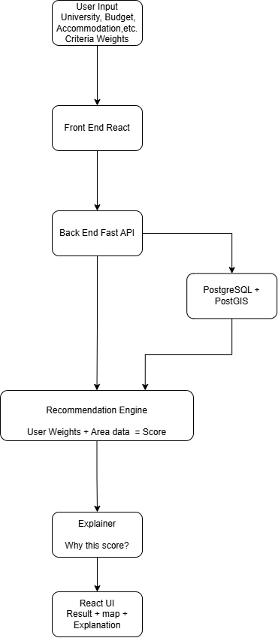






How we’ll build it
React + Leaflet
FastAPI
Recommendation engine
Form, ranked results, explanation panel, district map
REST layer linking the UI to the engine
Filter by budget, normalise, score
Explainer
PostgreSQL + PostGIS
Data ingestion
Kept separate from scoring
One row per district, one column per feature
One script per source, run offline
The Crib Crew · Find your Dublin · 8
Notes:
Front end: a React single-page app with a preference form, ranked results, an expandable explanation panel for each area, and a Leaflet map highlighting Dublin postal districts. Back end: a FastAPI REST layer, chosen because the engine is Python and FastAPI validates requests and generates API docs automatically, so front and back end can be built in parallel. The recommendation engine applies hard constraints first (budget, accommodation type), normalises attributes so low rent and high amenity counts score well, then computes a match score from the student's weights. The explanation generator is separate from the scoring logic so either can change independently. PostgreSQL with PostGIS stores one row per district with a column per scored feature. The ETL process runs separately from user sessions, with one script per source so one outage doesn't block the others.

Slide 9




Where the data comes from
RTB rents
OpenStreetMap
TFI GTFS
CSO Census 2022
Average rent by postal district
Shops, cuisines, gyms, parks, pharmacies
Travel times from each district to campus
Small-area community statistics
All open, free and redistributable — no commercial property sites needed
The Crib Crew · Find your Dublin · 9
Notes:
Rent: the RTB Average Rent dataset, reporting rents from registered tenancies by Dublin postal district. Amenities: OpenStreetMap via the Overpass API — supermarkets, restaurants with cuisine tags, gyms, parks and pharmacies per district. Commute: the Transport for Ireland GTFS schedule feed, used to compute travel times from each district to each major campus. Community: CSO Census 2022 small-area statistics.

Slide 10


Two ways we’ll test it
Is the model stable?
Do students agree?
Nudge each weight ±20% — does the top 3 hold?
10–15 international students: is their own pick in our top 3?
The Crib Crew · Find your Dublin · 10
Notes:
Robustness: we raise or lower each weight by 20 percent and count how often the top three areas change. If small changes flip the result, the model is not reliable. We also compare against an alternative scoring approach and analyse the differences. User testing: 10–15 international students first choose areas without the app, then fill in the preference form. We measure how often their choice was in our top three and ask how persuasive the reasoning was. Results feed straight into the next sprint: poor agreement means revisiting criteria and weights; low marks on phrasing means fixing the explanations; UI problems become front-end backlog items.

Slide 11





Five sprints, two weeks each
Scrum on GitHub Projects · every task has one owner and a deadline
SPRINT 1
SPRINT 2
SPRINT 3
SPRINT 4
SPRINT 5
Set up
Real data
Launch MVP
User testing
Polish
Repo, board, synthetic data
Collect Dublin data, fix features
Build and deploy
Feature freeze begins
Improve, document, submit
The Crib Crew · Find your Dublin · 11
Notes:
We use Scrum with two-week sprints, managed on GitHub Projects for the backlog, issues, code and task progress. Each sprint starts with planning and ends with a review and a retrospective. The Scrum Master role rotates each sprint; one person is Product Owner for the whole project to keep the backlog consistent. Sprint 1: GitHub repo and board, synthetic fixture, start data collection. Sprint 2: collect real Dublin data and finalise features and criteria. Sprint 3: build and deploy the MVP. Sprint 4: user evaluation with international students — no new features from this point. Sprint 5: improve based on evaluation results and complete documentation. Success means a deployed system that takes valid preferences and returns a justified list of Dublin areas with understandable explanations, plus an evaluation showing the recommendations help students.

Slide 12



Meet The Crib Crew
SS
VV
SS
SM
CC
Santhosh Sekar Asha
Vikneshwaran Venkatesh
Shreyash Chandradip Salunkhe
Sowmiya Madhan Kumar
Catheine Sherina David Chelladurai
Fridays
Tue / Wed
Rotating lead
In person, ~2 hours
Online stand-up
New lead each sprint
The Crib Crew · Find your Dublin · 12
Notes:
We meet in person every Friday after class for about two hours to plan and make decisions, plus a short online stand-up on Tuesday or Wednesday evening covering progress, blockers and next steps. A Microsoft Teams group carries project updates, kept up to date by that week's team lead. One member works night shifts, so meeting minutes are shared with him after each meeting, or he listens to the recording — nobody is excluded from decisions because of their work schedule. The team lead rotates at the start of each sprint.

Slide 13

HOW WE HANDLE DISAGREEMENT
An hour of testing beats an afternoon of arguing.
Raise it with the whole team · decide with evidence · escalate to our mentor early
The Crib Crew · Find your Dublin · 13
Notes:
Technical disagreements are healthy — we would rather spend an hour testing which approach is better than an afternoon arguing. Suggestions or disagreements go to the whole team, not one member, and the team decides together; no single person has a veto. If we can't agree, the team lead or the person who knows that area best decides. If someone starts affecting the team (missing meetings, pushing code late), we talk to them first; if it continues, the team agrees a specific change in a meeting; if it's still unresolved after a full sprint, it goes to our mentor. Clear ownership of every task avoids most conflict.

Slide 14
Thank you
Success: valid preferences in, a justified shortlist of Dublin areas out — and proof that it helps students.
Questions?
Notes:
Thank you. Our success criteria: a deployed system that accepts a valid combination of preferences from international students and returns a justified list of Dublin neighbourhoods with understandable explanations, plus an evaluation showing these recommendations are genuinely helpful. Happy to take questions.

